Slide 1
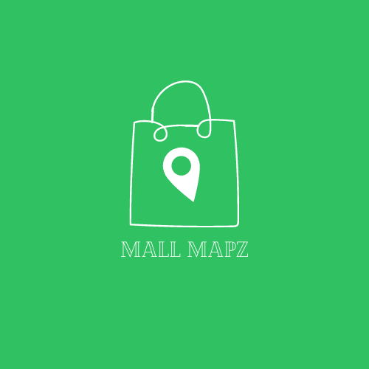


Slide 2
Hello!
The Cartographers
Lara Leyson, Daniel Pearson, Romer Rodriguez

Slide 3
What is Mall mapz?
Mall Mapz is an interactive application used for malls.
Mall Mapz is here to guide you in the right direction. One foot at a time.

Slide 4
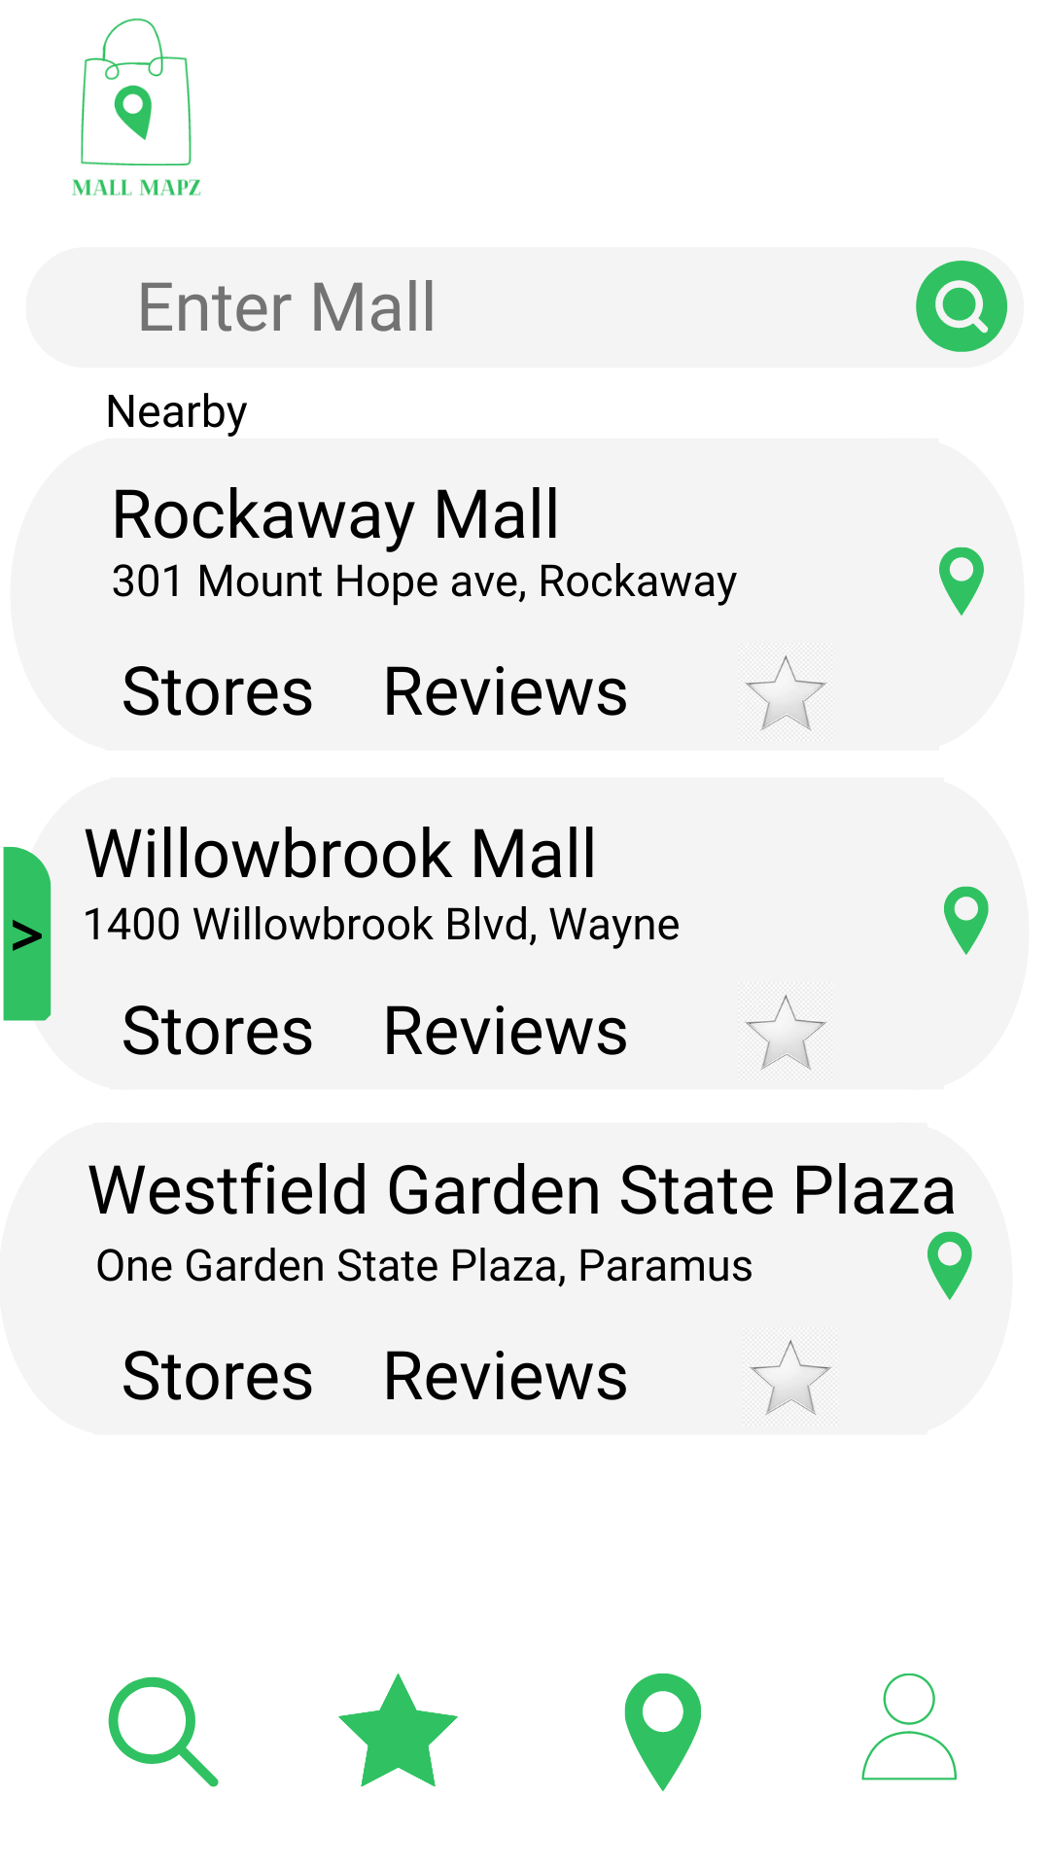
Search
Allows user to search for mall, store, or restaurant
Notes:
https://www.canva.com/

Slide 5
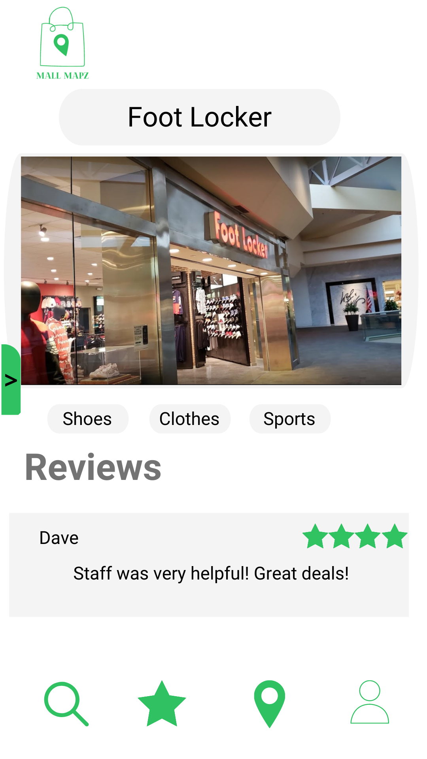
Store Info
Provides user with information about specific stores
Notes:
https://www.canva.com/

Slide 6
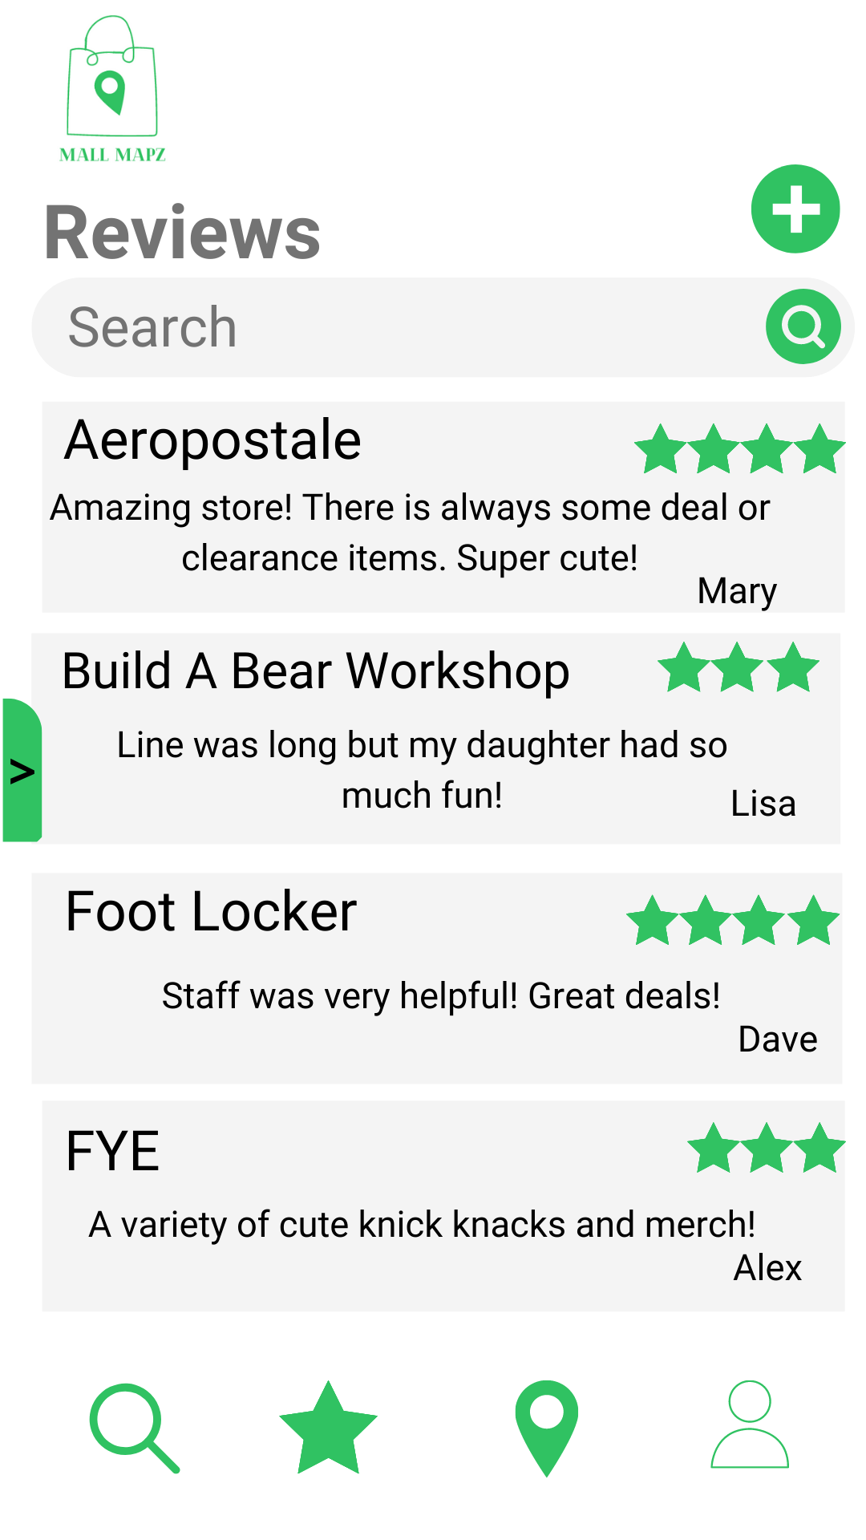
Reviews
Allows user to:
Add a review
Search for specific reviews based on mall, store and restaurant
Displays most recent reviews
Notes:
https://www.canva.com/

Slide 7
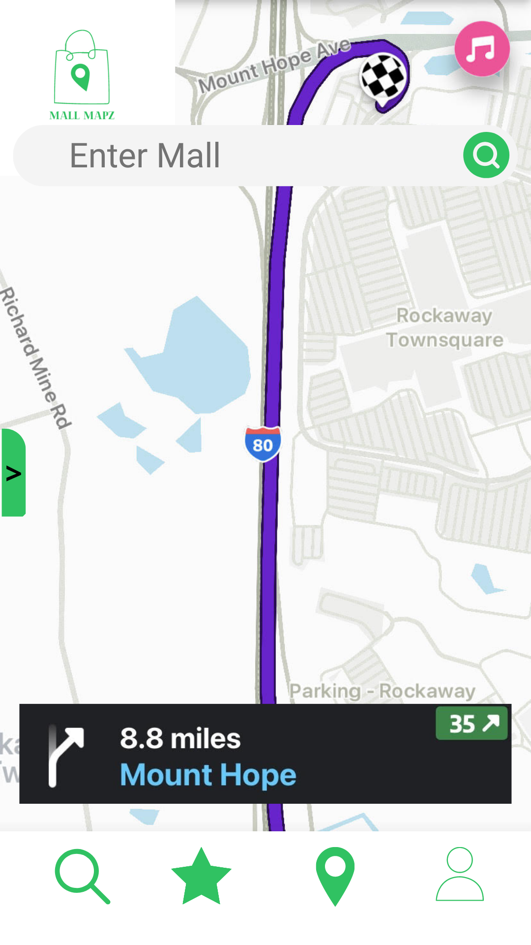
GPS
Directions to the mall
Notes:
https://www.canva.com/

Slide 8
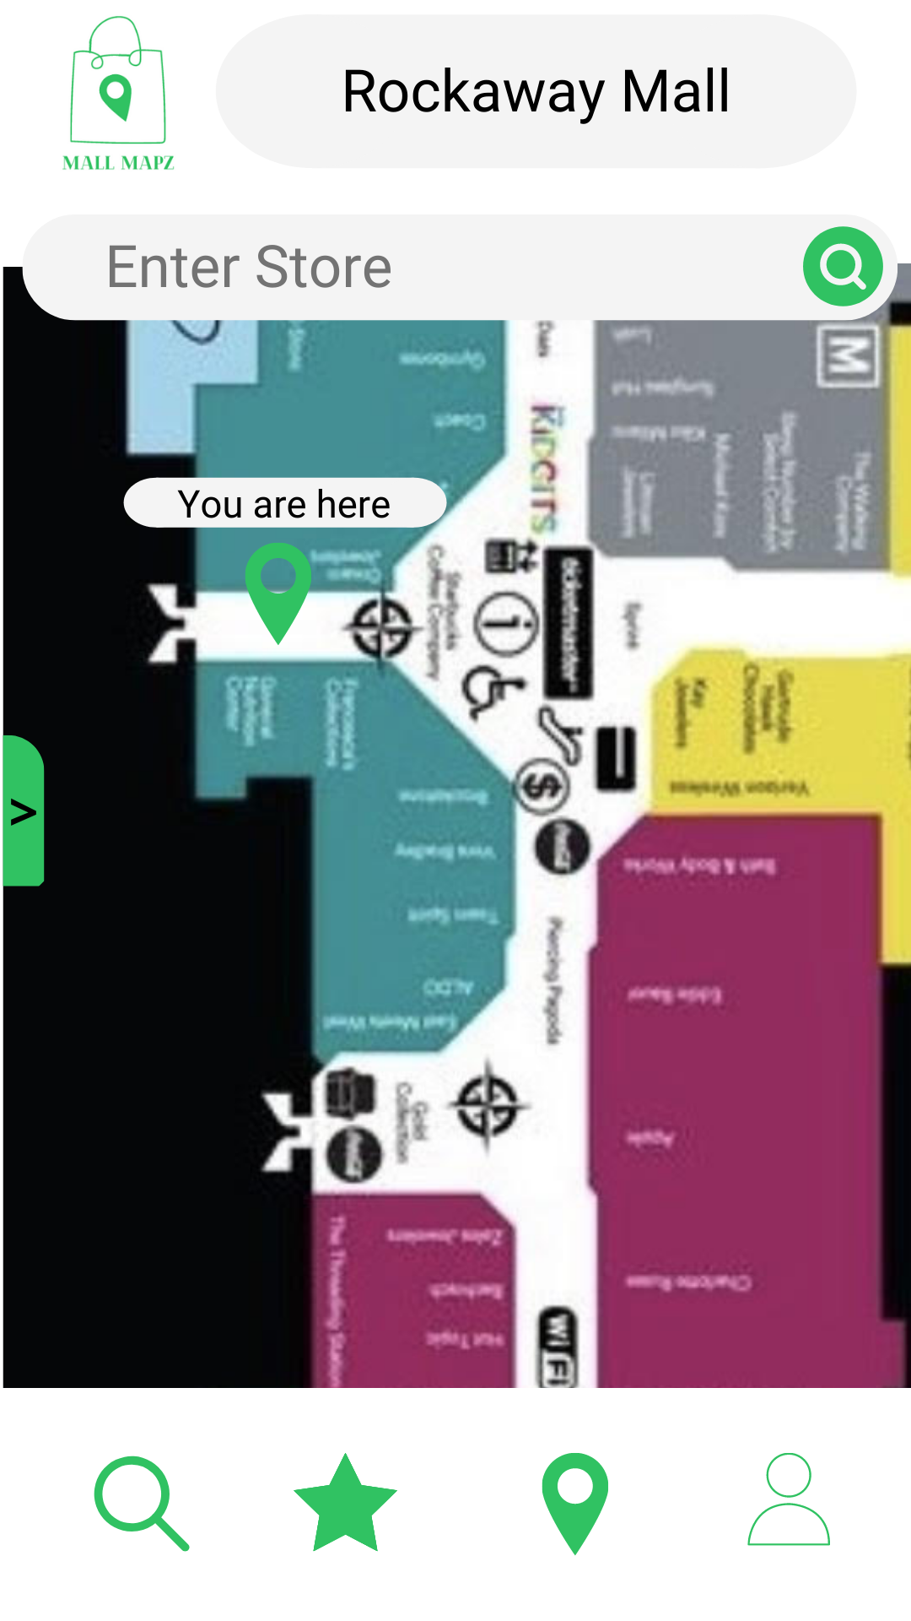
Mapz
Directs user to specific store or restaurant
Notes:
https://www.canva.com/

Slide 9
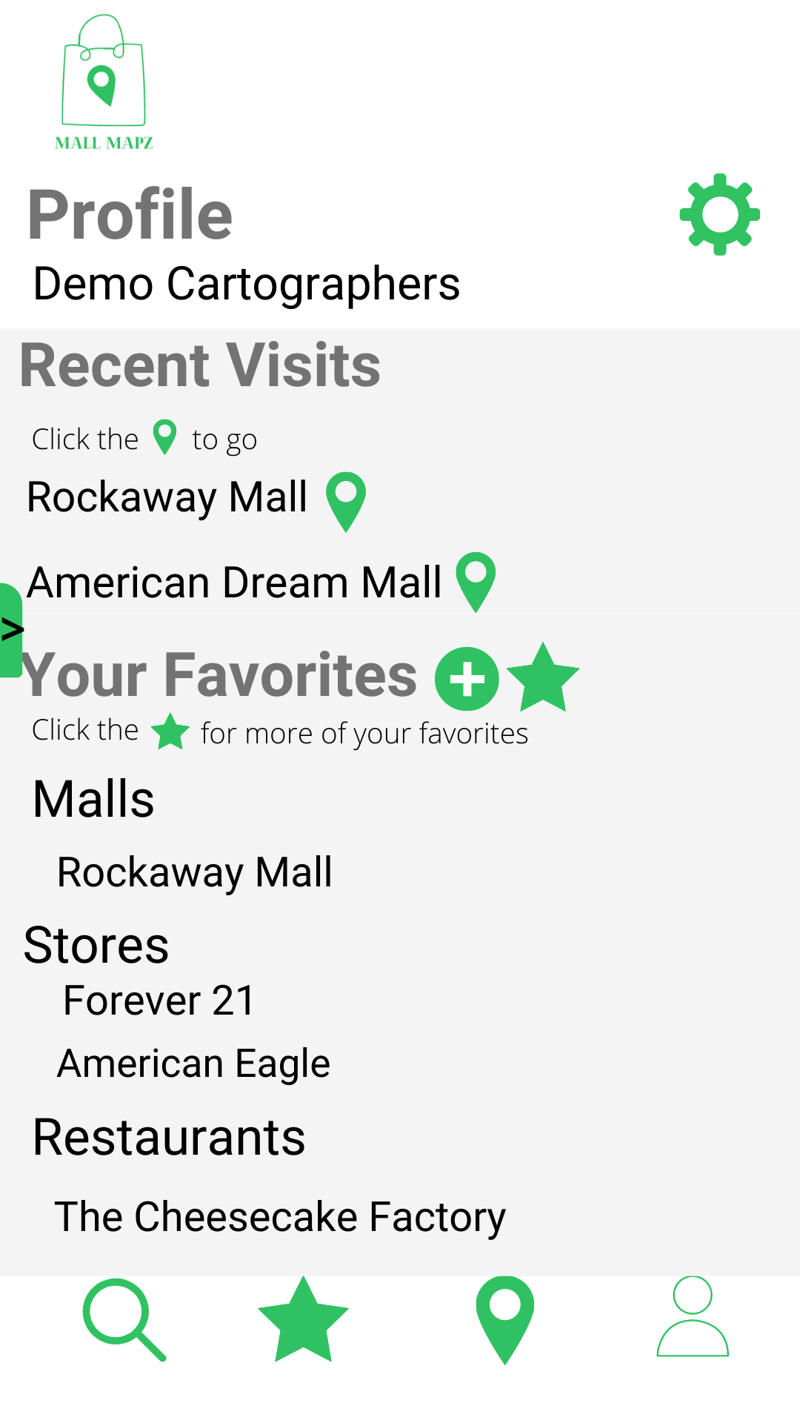
profile
Displays recent mall visits and user favorites
Notes:
https://www.canva.com/

Slide 10
THANKS!
Any questions?

